Slide 1
Police Violence
Using Data to examine the narrative

Slide 2
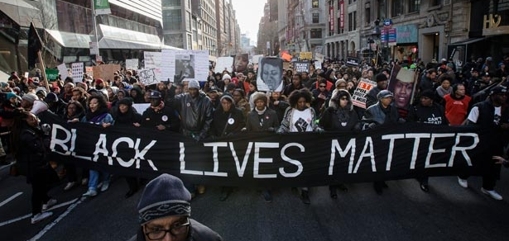
What’s the narrative?
Deaths of Michael Brown, Freddie Gray, Eric Garner, Walter Scott, Tamir Rice, Sandra Bland
Lack of prosecution leads to Black Lives Matter
Broader awareness of police violence & race
Pew & Gallup

Slide 3
DATA SOURCE
MappingPoliceViolence.org – Sourced from three separate websites
FatalEncounters.org – Kept by Cal State Fullerton and Reno News & Review
KilledByPolice.net – Facebook Community compiling and coding news reports (https://www.facebook.com/KilledByPolice/)
U.S. Police Shootings Data – Compiled by Deadspin (http://regressing.deadspin.com/were-compiling-every-police-involved-shooting-in-americ-1624180387

Slide 4
Questions
What factors predict whether an officer is charged with a crime?
2.6% of police involved in a killing were charged
What factors predict whether a police killing is deemed “justified”?
21% of police killings were deemed justified

Slide 5
Factors Examined
Age – Under 18, 18-24, 25-44, 45-64,65 and older
Race – White, Black, Hispanic, Asian, Pacific Islander, Native American, Unknown
Gender – Male, Female
Armed – Allegedly Armed, Vehicle, Unarmed, Unknown
Mental Illness – Yes, Drugs/Alcohol, No, Unknown

Slide 6
Charged – METHODS Attempted
Logisitic Regression
No factors performed better than the null (97.37%)
Multinomial Naïve Bayes
Function that included all factors did not perform better than null
Random Forest
Factors are largely unhelpful but gave hierarchy

Slide 7
Charged – Factor Importance

Slide 8
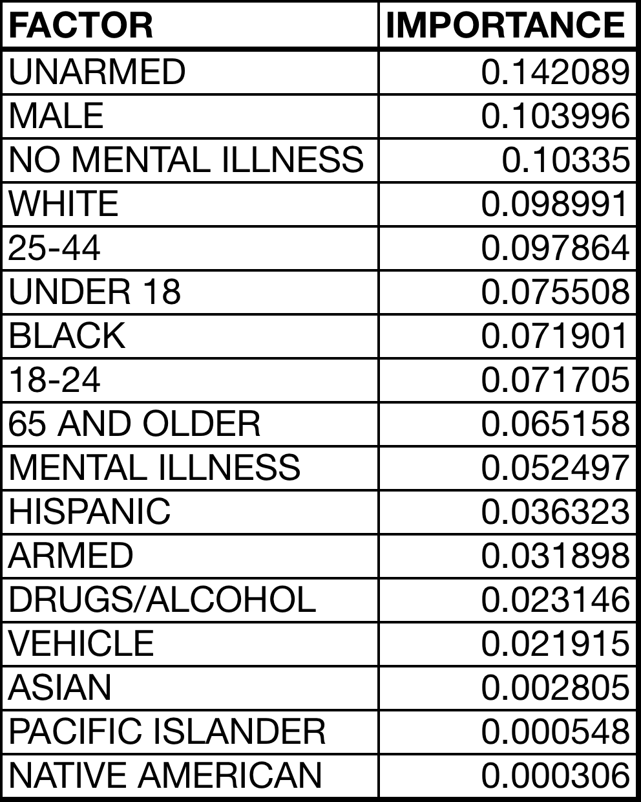
CHARGED – Results
No method produced results better than the null
Most important factors:
Unarmed
Male
No Mental Illness
White

Slide 9
JUSTIFIED – METHODS Attempted
Logisitic Regression
No factors performed better than the null (78.55%)
Multinomial Naïve Bayes
Function that included all factors did not perform better than null
Random Forest
Factors are largely unhelpful but gave hierarchy

Slide 10
JUSTIFIED – Factor Importance

Slide 11
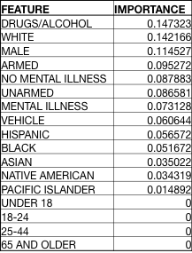
Justified – Results
No method produced results better than the null
Most important factors:
Drugs/Alcohol
White
Male

Slide 12
Conclusions & next steps
Very little found for two main questions
Importance of factors gives a clue as to some problems in system
Direction of factors would be good to know to confirm or deny narratives
Other methods to try?
Other interesting questions?

